Slide 1
VALENCE BOND THEORY
Presented by-
Sumit
B.E(IT) 1st year

Slide 2
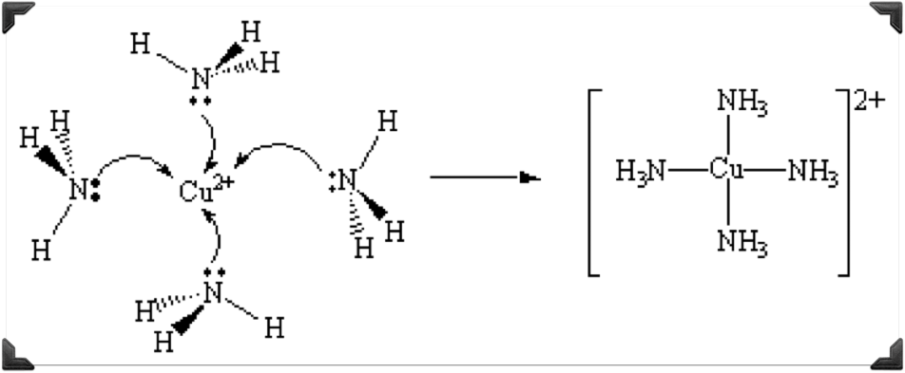

INTRODUCTION TO SIDGWICK’S THEORY(1927)
" Effective atomic number is the total number of electrons present around central metal ion in a complex.”
EAN=[Atomic number of the metal]-[Number of electrons lost in the formation of ion] + [Number of electrons gained from ligands].
Example: (Cu(NH3)4)2+
EAN = {29 - 2 + 4(2)} = 35

Slide 3
DEFECTS IN SIDGWICK’S THEORY SOLVED BY VBT
There are many complex ions known which do not follow Sidgwick's effective atomic number rule. For example. all those metal ions which exhibit more than one coordination number depending upon the nature of the ligand such as Ni(lI), Co(11), Fe(Ill) etc., violate this rule. Complexes of iron(III) like FeCl; and Fe(CN)3- do not obey this rule.
This theory cannot predict the type of metal orbitals which may be involved in bonding.
This theory cannot predict the magnetic behaviour of complexes.
This theory cannot predict the geometry of the complex.
This theory cannot explain as to why certain metal ions exhibit more than one coordination number.

Slide 4
The three main theories of bonding of coordination compounds are:
1. Valence bond theory
2. Crystal field theory
3. Molecular örbital theory.

Slide 5
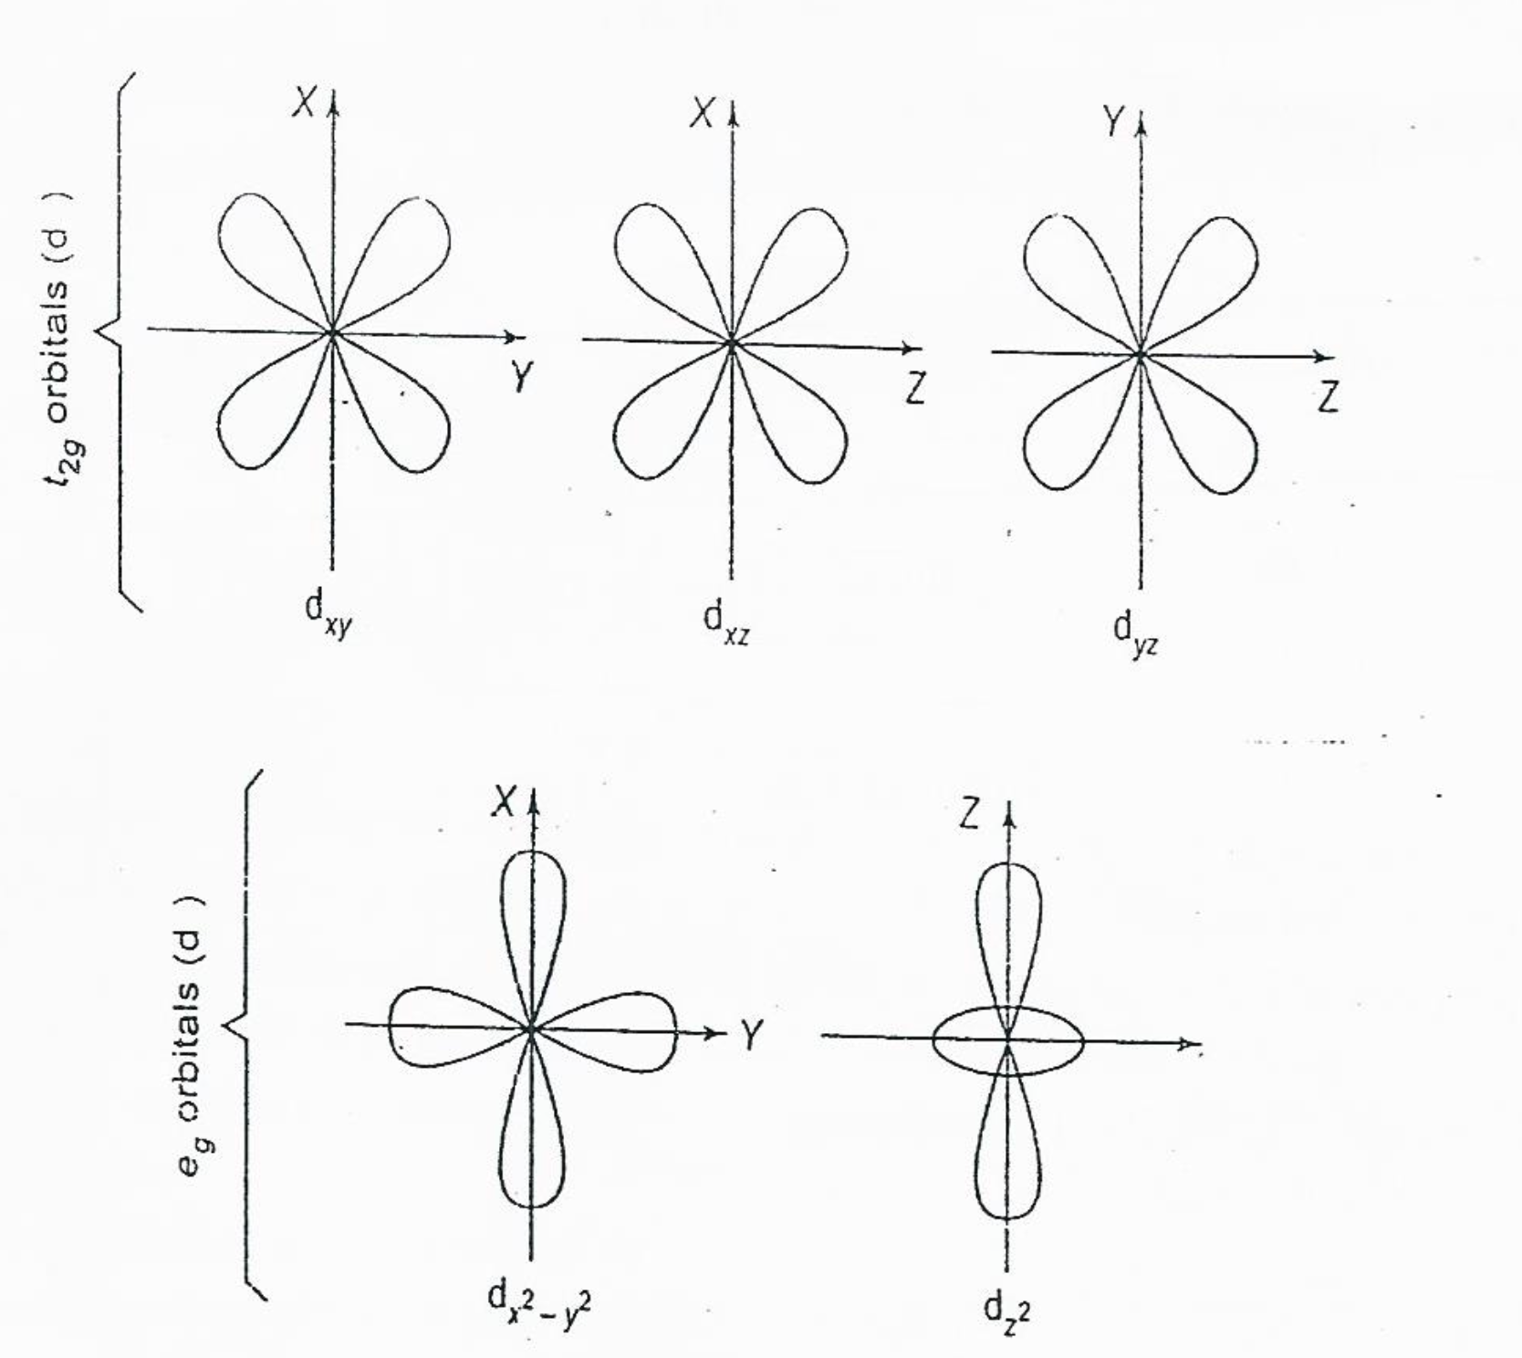
SHAPES OF D-ORBITAL

Slide 6
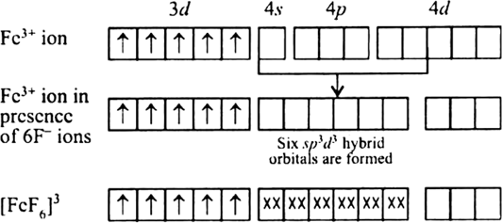
VALENCE BOND (VB) THEORY
The valence bond treatment of bonding of complexes was mainly developed by Pauling. This theory is the simplest of the three theories and is easy to apply. It gives fairly accurate explanation of the structures and magnetic properties of a large number of coordination compounds.

Slide 7
Salient features
of this theory
The central metal atom in the complex provides a number of empty orbitals equal to its coordination number for the formation of coordinate bonds with appropriate ligand orbitals.
* The formation of a strong bond requires that the overlap of metal orbitals with ligand orbitals should be as large as possible. In order to achieve this, the atomic orbitals of metal hybridise to form a new set of equivalent hybridized orbitals with definite directional properties.

Slide 8
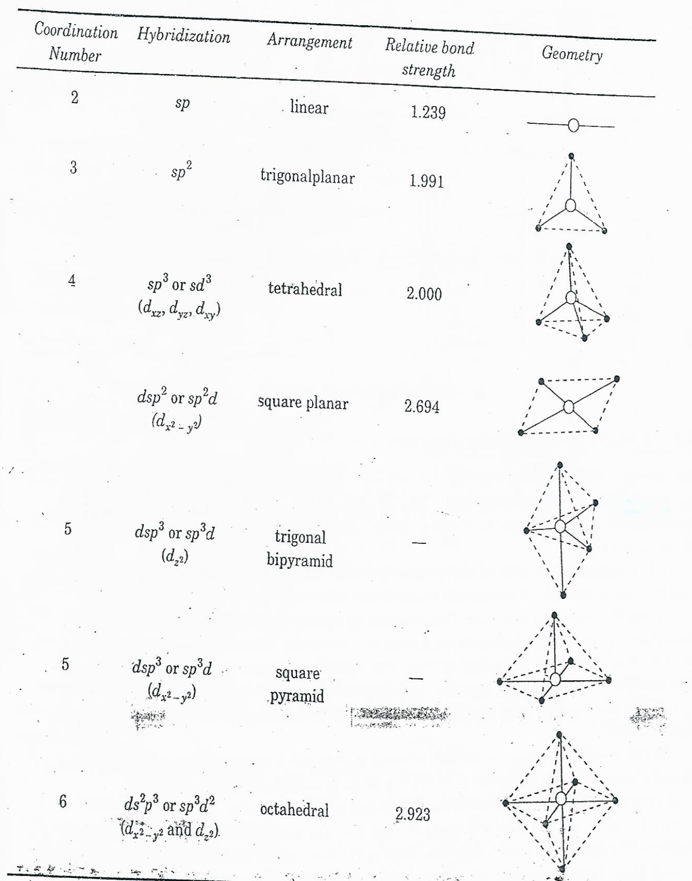

Slide 9
*The non-bonding metal electrons occupy the inner d-orbitals which do not participate in the hybridization.
*The d-orbitals involved in the hybridization scheme which are required to accommodate the ligand electrons may be either inner (n - 1) d orbitals or outer (n)d orbitals.
*Each ligand (donor group) must contain a lone pair of electrons.
*A covalent &-bond is formed by the overlap of a vacant hybridized metal orbital and a filled orbital of the ligand. The bond is also sometimes called a coordinate bonds.
*If we know the umber of unpaired electrons in the metal complex, it is then possible to predict the geometry of the complex.
The reverse is also true, i.e. if the geometry of the complex is known, one may predict the number of unpaired electrons.

Slide 10
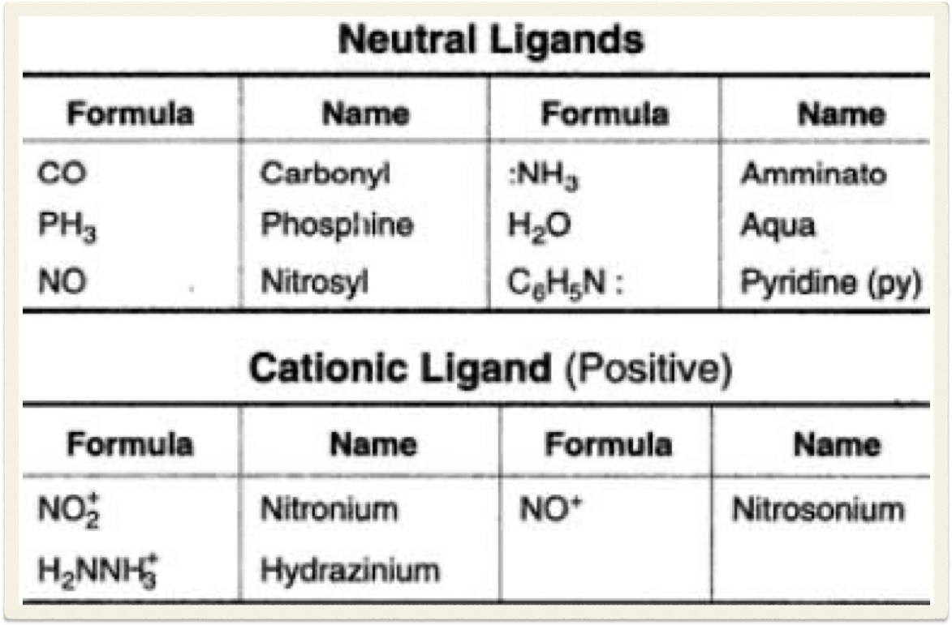
Types of ligands

Slide 11
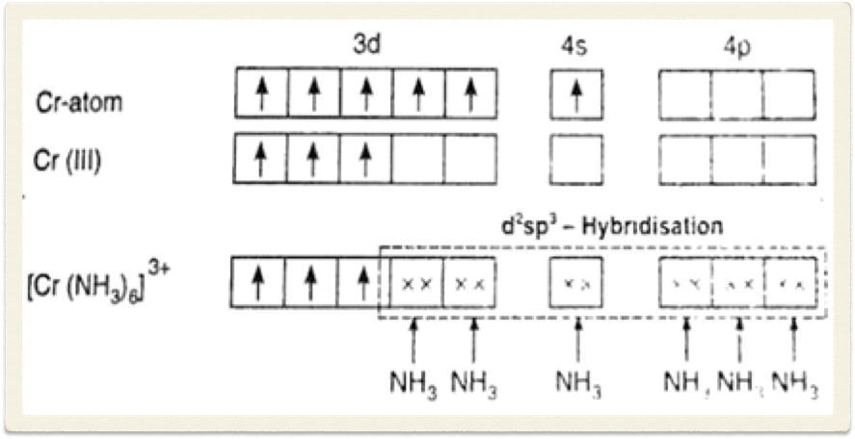
[Cr(NH3)6]+
The 3d electrons of chromium ton occupy the inner d orbitals (dyz, dxz and dxy) in accordance with Hund's first rule. A set of six d2sp3 (dx2-y2, dz2, S, Py, Px, and Pz.) hybrid orbitals are formed and these are occupied by electron pairs (marked as xx) donated by six ammonia ligands. The complex ion has octahedral geometry and will show paramagnetism due to three unpaired electrons.

Slide 12
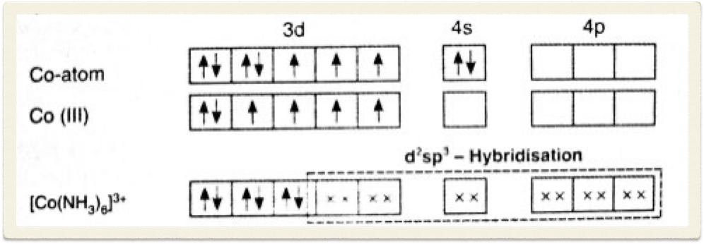
[Co(NH3)6]+
It is obvious that in order to construct six d' sp hybrid orbitals, the metal ion shall have to vacate two of its 3d orbitals. This can be achieved in two ways. The two 3d electrons can either be pushed to higher energy vacant 4d or 5s orbitals or they may pair off with the other two singly occupied 3d electrons. It is known that less energy is required to pair the two electrons than to promote them to the higher energy orbitals. Accordingly, we have the following representation:

Slide 13
{CoF6}3-
We may, therefore, predict that [Co(NH3)6]+ ion shall be diamagnetic (no unpaired electron) and this has been experimentally verified. From the above discussion we may generalise that all octahedral complexes should be diamagnetic. But this is not true. It was soon established that the complex is paramagnetic and has four unpaired electrons: In order to explain this anomaly, it was proposed by Pauling that such metal-ligand bonds as in (CoF6)3- are primarily ionic. As the fluoride ion is highly electronegative the explanation of ionic bonding in (CoF6)3-offered by Pauling was accepted at that time.

Slide 14
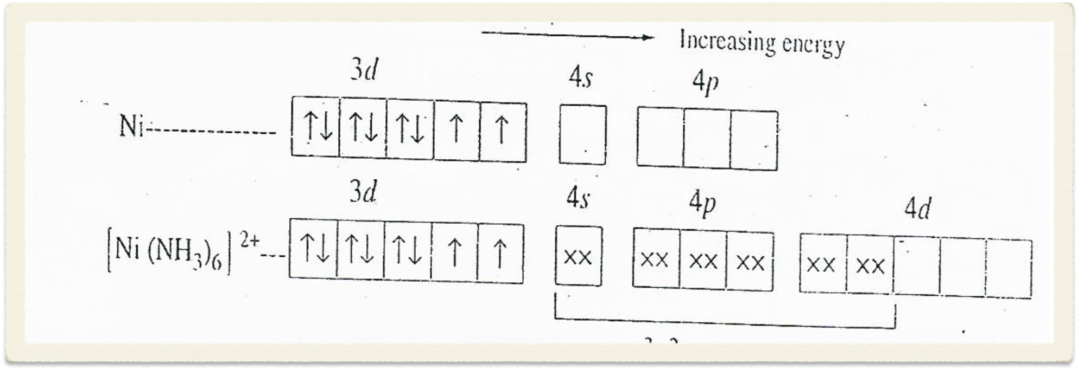
{Ni(NH3)6}2+
Now in order to make available d orbitals required for d2sp3 hybridization we may promote two 3d electrons to the energetically unfavourable 4d orbitals but it is highly improbable. In order to account for the paramagnetism. we may have to assume that the complex{Ni(NH3)6}2+is ionic. But the assumption that the bonding in {Ni(NH3)6}2+ is ionic is not very convincing. Other octahedral Ni2+ complexes such as {Ni(H2O)6}2+, {Ni(en)6}2+etc. are all paramagnetic and to assume that they are also ionic compounds will be wrong because these complexes show properties which are associated with covalent compounds.

Slide 15
Huggins 1937
An alternative explanation was proposed by Huggins in 1937. to solve this anomaly. He suggested that when a choice of hybrid orbitals is available, the metal may either use inner (n - 1)d nsnp3 orbitals for hybridization or outer (n)d nsnp3 orbitals. If the complex is formed by the use of inner (n- 1)d orbitals then the resulting complex is called an inner orbital complex or alternatively if outer nd orbitals are employed then the complex is called an outer orbital complex, and the metal ion will then said to be Sp3d2 hybridized for octahedral geometry.

Slide 16
Types of complexes
An inner orbital complex is formed by pairing the electrons of the metal ion and making available all those orbitals which may be required for bond formation. These complexes will be either diamagnetic or shall have reduced paramagnetism. They are called low-spin or spin-paired complexes.
On the other hand, complexes formed by the use of outer nd orbitals will be paramagnetic. These complexes are called high-spin or spin-free complexes.

Slide 17
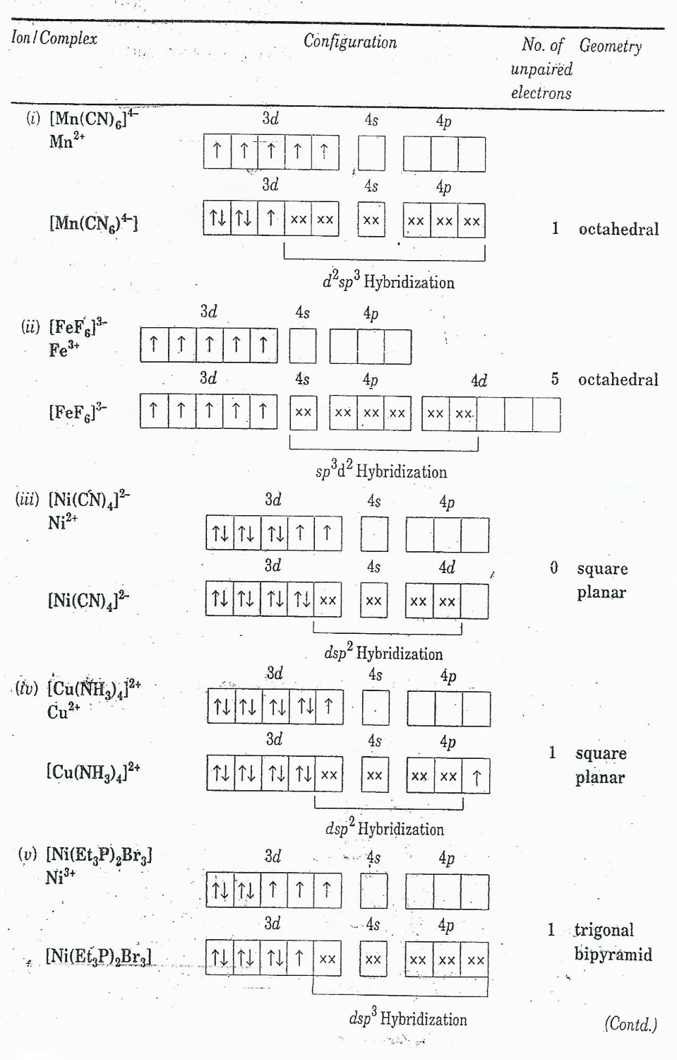

Slide 18

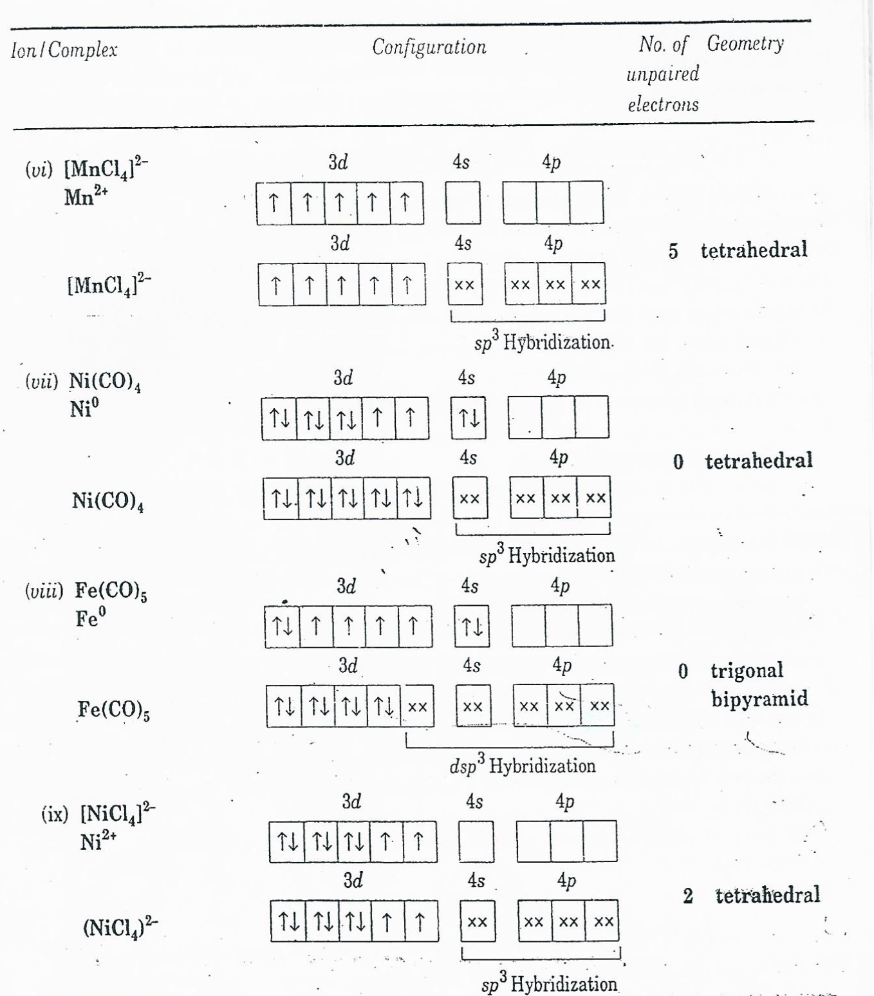

Slide 19
Limitations of VB Theory
*It is limited to qualitative explanations only
*It does not explain the prediction or interpretation of spectra of complexes.
*It does not account for detailed magnetic properties. It cannot explain high and low values of magnetic moment for complexes. It can only predict the number of unpaired electrons in a coordination compound.
*It does not account for the relative stabilities of different structures.
* It does not predict the relative stabilities of different ligands.
*It does not take into consideration splitting of d energy levels.
*It cannot predict as to which of the five d-orbitals the metal ion will provide for ligand electrons..

Slide 20
*It cannot explain why certain complexes are more labile than others? Labile complexes are those in which one ligand can be easily displaced by another ligand. On the other hand. inert complexes are those in which displacement of ligands is slow.

Slide 21
